Slide 1
The Battle of Neighborhood

Slide 2
Introduction
The main target of this project is to find similarities between the cities and clusters together so that we can find popular items in that location.
It will provide the best places to visit near you depending upon your interest.

Slide 3
Data
We can use the real-time location data by using the geocoders module and Geospatial coordinates file.
The data from the previous project (Assignment) can also be used.
Foursquare data can be used.

Slide 4
Methodology
The required location can be found using geocoders module.
Foursquare API can be used to obtain the nearest places of the given location.
Clustering (Un-supervised Machine Learning Algorithm) is used to group the locations with similar properties.

Slide 5
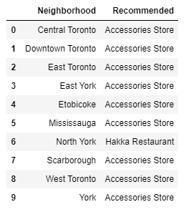
Result
Merchants can setup their business in recommended category to get more profit.
The people who are new to the places can also use this system to obtain restaurants/clubs/etc.

Slide 6
Conclusion
This project is very useful for most of the travellers as they did not know the new place and what is popular in that place.
It provides the information about what they want in that place.
It also make profits for the business man as it suggests the places to set up the new business so that, there will be more people to buy their product

